Slide 1



Mitigating Hallucinations in Large Vision-Language Models via DPO:
On-Policy Data Hold the Key
Zhihe Yang^{1†}, Xufang Luo^{2*}, Dongqi Han², Yunjian Xu^{1*}, Dongsheng Li²
The Chinese University of Hong Kong, Hong Kong SAR, China
Microsoft Research Asia, Shanghai, China
(† for Speaker, and * for Corresponding authors)

Slide 2
Background
Hallucinations in LVLMs
Existing solutions

Slide 3
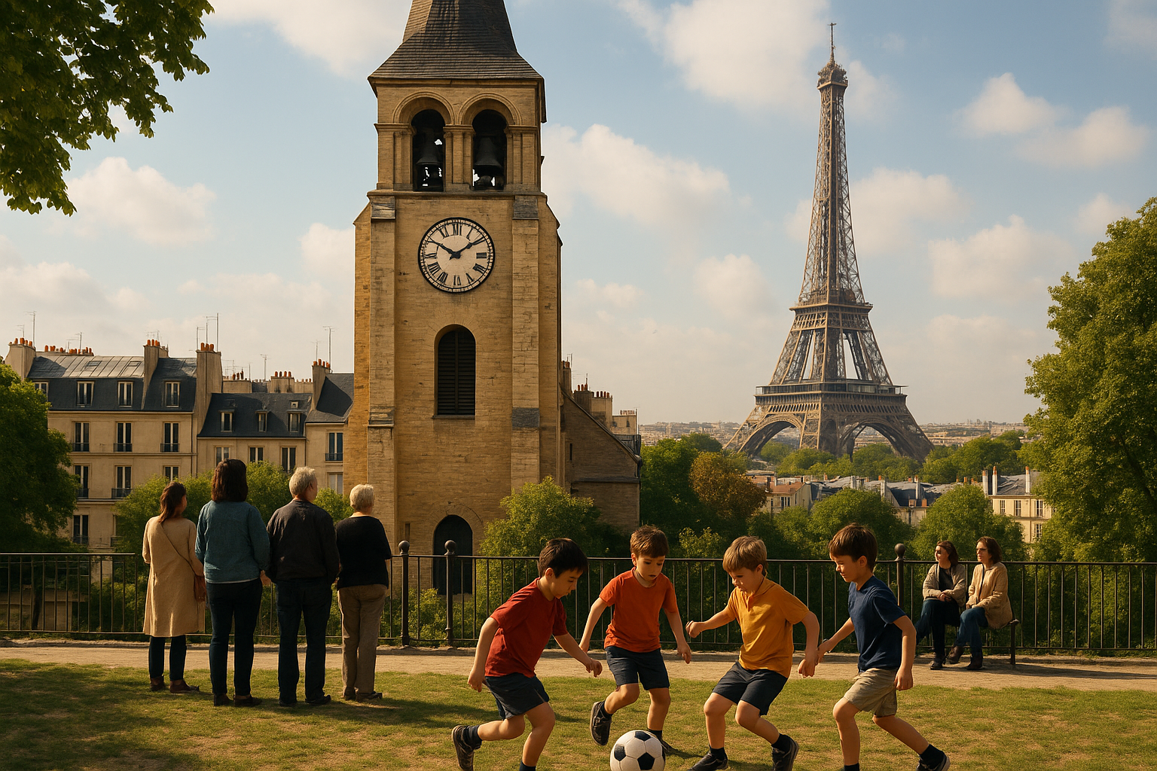



Hallucinations in LVLMs
Could you please describe the given image?
RED text: Hallucination GREEN text: Corrections
Real LVLM:
… In the foreground, three children are playing basketball on a grassy area…
Ideal LVLM:
… In the foreground, four children are playing football on a grassy area…
Notes:
Too much info
One thing is enough

Slide 4
Solutions for Hallucinations in LVLMs
Class 1: Training-free
Contrastive decoding; Attention pattern manipulation; Special tokens avoidance…
Class 2: Training(RL)-based (Generally introduce better results)
$π_{θ}$ - current policy; $π_{ref}$ - initial (reference) policy;
$x$ - prompt; $y$ - response; $m$ - image; $r(x,y,m)$ - reward function from BT model
Initial Objective:
Direct Preference Optimization (DPO)^{[1]} is the most effective and popular solution
Practical Loss:
Preferred Response
Rejected Response
… In the foreground, four children are playing football on a grassy area…
>
… In the foreground, three children are playing basketball on a grassy area…
Could you please describe the given image?
[1] Rafailov R, et al. Direct preference optimization: Your language model is secretly a reward model. NeurIPS (2023).

Slide 5
Our Contributions
Conduct systematic review of DPO-based algorithms for addressing hallucinations in LVLMs.
Identify intrinsic property of DPO, specifically its high reliance on on-policy data.
Propose OPA-DPO, a simple yet highly effective algorithm achieving SOTA performance with only 4.8k data points.

Slide 6
Problem Analysis
Summary of DPO-based methods

Slide 7
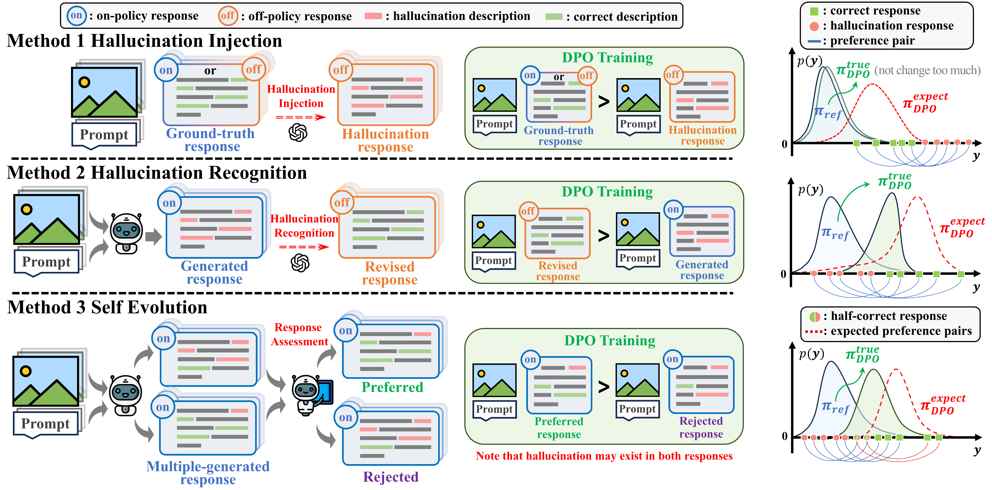
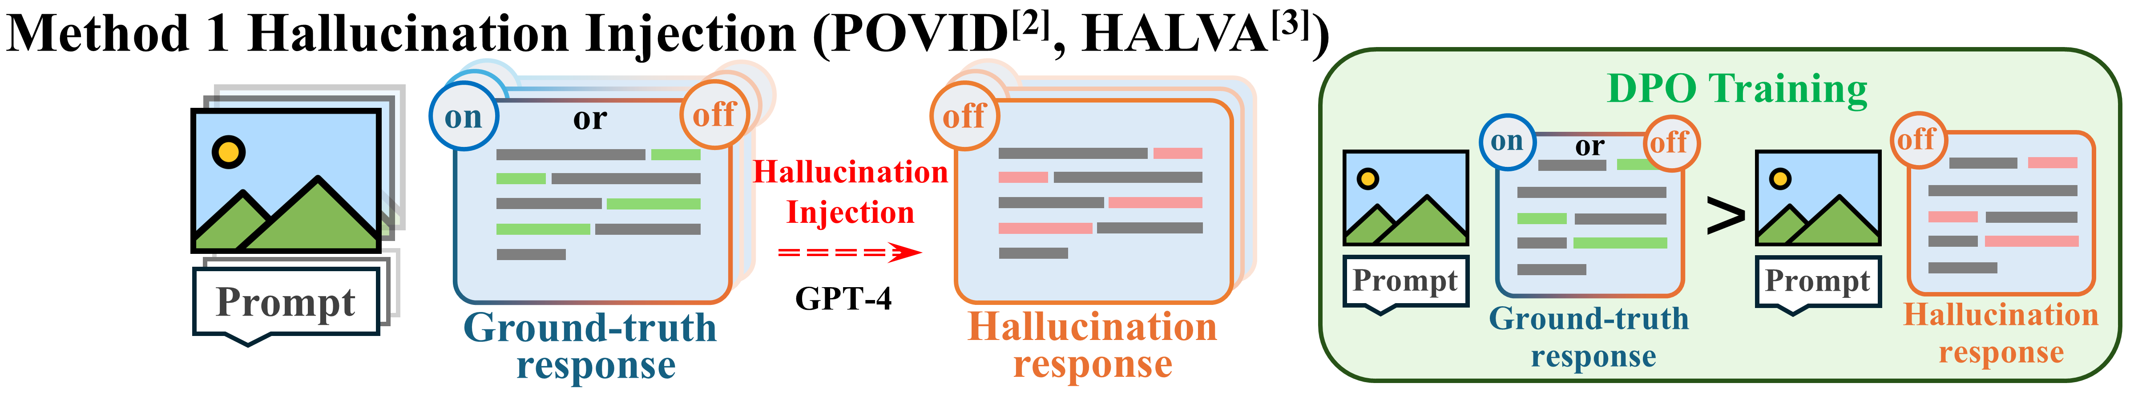
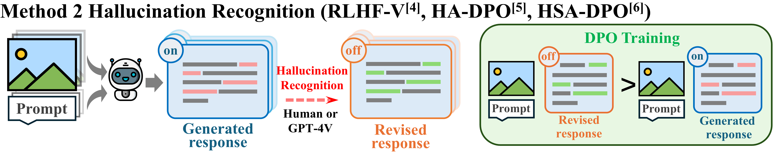
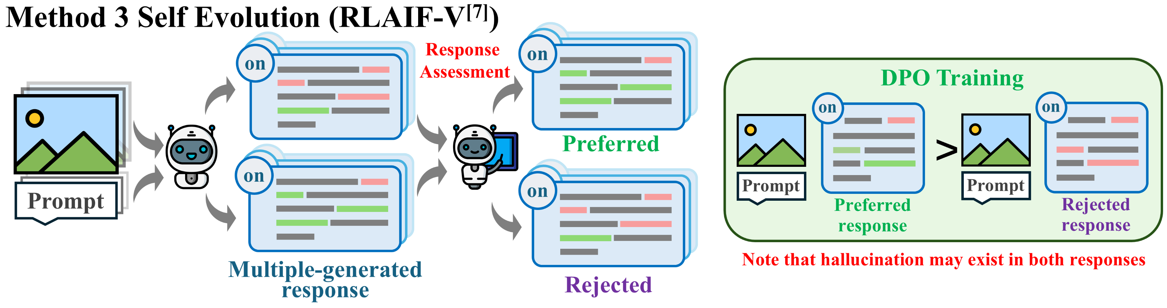
Summary of DPO-based methods
Method 1:
Hallucinations not from the model, should be least effective.
Method 2:
Precise feedback and correction, should be most effective.
Method 3:
Dimensional disaster,
persistent hallucinations are difficult to eradicate.
Intuition: 2 > 3 > 1
Fact: 3 > 2 > 1
[2] Zhou Y, et al. Aligning Modalities in Vision Large Language Models via Preference Fine-tuning. ICLR (2024).
[3] Sarkar P, et al. Data-augmented phrase-level alignment for mitigating object hallucination. arXiv:2405.18654 (2024).
[4] Yu T, et al. RLHF-V: Towards trustworthy MLLMs via behavior alignment from fine-grained correctional human feedback. CVPR (2024)
[5] Zhao Z, et al. Beyond hallucinations: Enhancing LVLMs through hallucination-aware direct preference optimization. arXiv:2311.16839 (2023).
[6] Xiao W, et al. Detecting and mitigating hallucination in large vision language models via fine-grained ai feedback. AAAI (2025).
[7] Yu T, et al. RLAIF-V: Aligning MLLMs through open-source ai feedback for super gpt-4v trustworthiness. CVPR (2025).

Slide 8
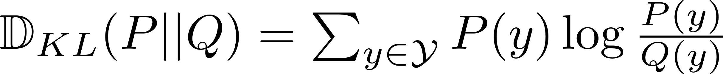
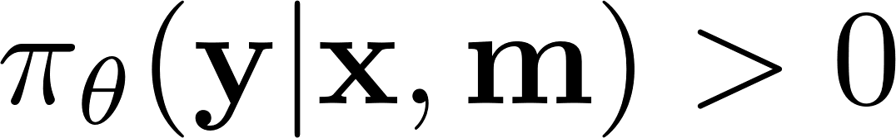
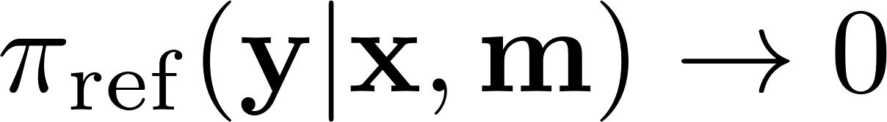
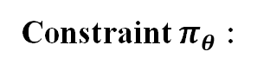
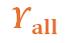
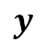
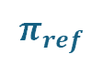
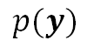
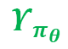
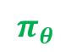
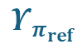
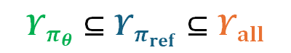
Why Facts Conflict with Intuitions (3 > 2)?
Recall Initial Objective of DPO:
Definition of KL divergence:
A fact for KL divergence:
Off-policy responses can NEVER be learned by any policy starting from initial objective
Constraint $π_{θ}$ :
$$p(y)$$
$$π_{θ}$$
$$π_{ref}$$
off-policy
set
$$Υ_{π_{θ}}⊆Υ_{π_{ref}}⊆Υ_{all}$$
$$Υ_{π_{θ}}$$
$$y$$
$$Υ_{π_{ref}}$$
$$Υ_{all}$$

Slide 9

Why Facts Conflict with Intuitions (3 > 2)?
Recall Initial Objective of DPO:
Definition of KL divergence:
A fact for KL divergence:
Off-policy responses can NEVER be learned by any policy starting from initial objective
Constraint $π_{θ}$ :
$$p(y)$$
$$π_{θ}$$
$$π_{ref}$$
off-policy
set
$$Υ_{π_{θ}}⊆Υ_{π_{ref}}⊆Υ_{all}$$
$$Υ_{π_{θ}}$$
$$y$$
$$Υ_{π_{ref}}$$
$$Υ_{all}$$

Slide 10
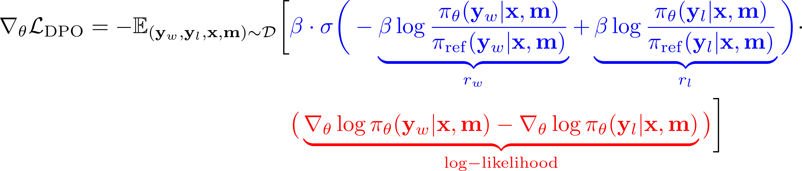
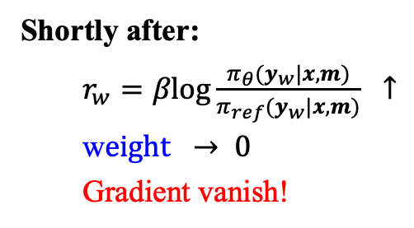
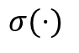
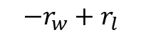
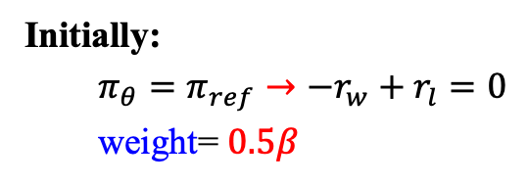
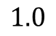
Why Facts Conflict with Intuitions (3 > 2)?
Off-policy responses can NEVER be learned by any policy starting from initial objective
DPO with off-policy preferred responses?
weight
gradient
Initially:
$π_{θ}=π_{ref}→{−r}_{w}+r_{l}=0$
weight= $0.5β$
$$σ(⋅)$$
$$1.0$$
Shortly after:
$r_{w}=βlog\frac{π_{θ}(y_{w}|x,m)}{π_{ref}(y_{w}|x,m)} ↑$
w$eight → 0$
Gradient vanish!
$$−r_{w}+r_{l}$$
Notes:
Clear introduction of weight of gradient

Slide 11
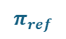

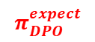
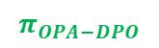

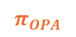
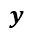
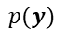
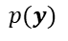
How should we fix this issue?
Method 2 (Hallucination Recognition)
Pros: Fine-grained correction
Cons: Off-policy
Method 3 (Self-Evolution)
Pros: On-policy
Cons: Fail for persistent hallucinations
Can we combine their pros?
: correct
SFT on Preferred Responses before DPO
(On-Policy Alignment DPO)
: hallucination
: preference pairs
$$π_{DPO}^{true}$$
$$p(y)$$
$$π_{DPO}^{expect}$$
$$p(y)$$
$$π_{ref}$$
$$π_{OPA−DPO}$$
$$π_{ref}$$
$$π_{OPA}$$
0
0
$$y$$
$$y$$
Off-policy preferred responses
cannot be learnt
OPA solves the problem

Slide 12
Methodology (OPA-DPO)
A solution combining advantages of method 2 and method 3

Slide 13




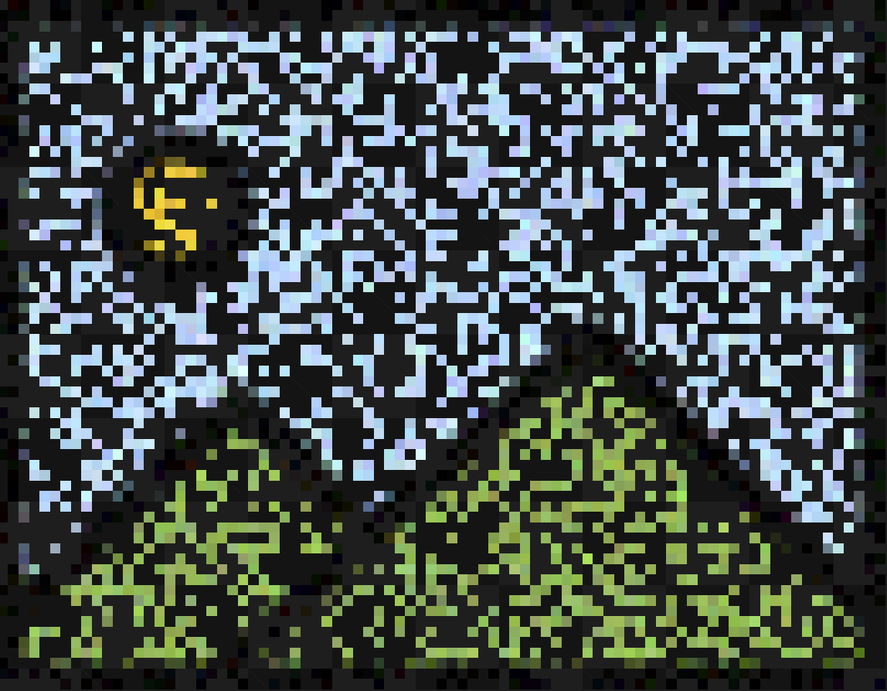


OPA-DPO Diagram
Instruct-Dataset
①
Generated
response
②
Revised
response
: off-policy data flow
off
Original
policy
: on-policy data flow
on
off
Hallucination
Recognition
: LMM training flow
Prompt
GPT-4V
Ground-truth
response
(Gen.)
Step1: Responses Generation.
DPO Training (six pairs)
④
Step2: Hallucination Correction
③
On-Policy
Alignment
+
on
+
on
Step3: OPA Operation
G.T.
Rev.
on
off
Prompt
>
Prompt
>
Ground-truth Response
(G.T.)
Language Correction
on
on
Step4: DPO training on the basis of OPA model.
Note: Image Focus and
Anchor pairs are firstly introduced in mDPO^{[8]}.
+
Gen.
+
Gen.
New
policy
Prompt
Prompt
+
on
+
on
LoRA-SFT
G.T.
Rev.
Prompt
>
Prompt
>
Image Focus
on
on
on
off
+
G.T.
+
Rev.
Revised Response
(Rev.)
Prompt
Prompt
+
on
+
on
G.T.
Rev.
Anchor
Prompt
>
Prompt
>
All three responses w.r.t. the new policy are “on-policy”
DPO will start from this policy
$$δ$$
$$δ$$
[8] Wang F, et al. mDPO: Conditional Preference Optimization for Multimodal Large Language Models. EMNLP (2024).

Slide 14
Experimental Results
Evaluation on hallucination-related metrics

Slide 15
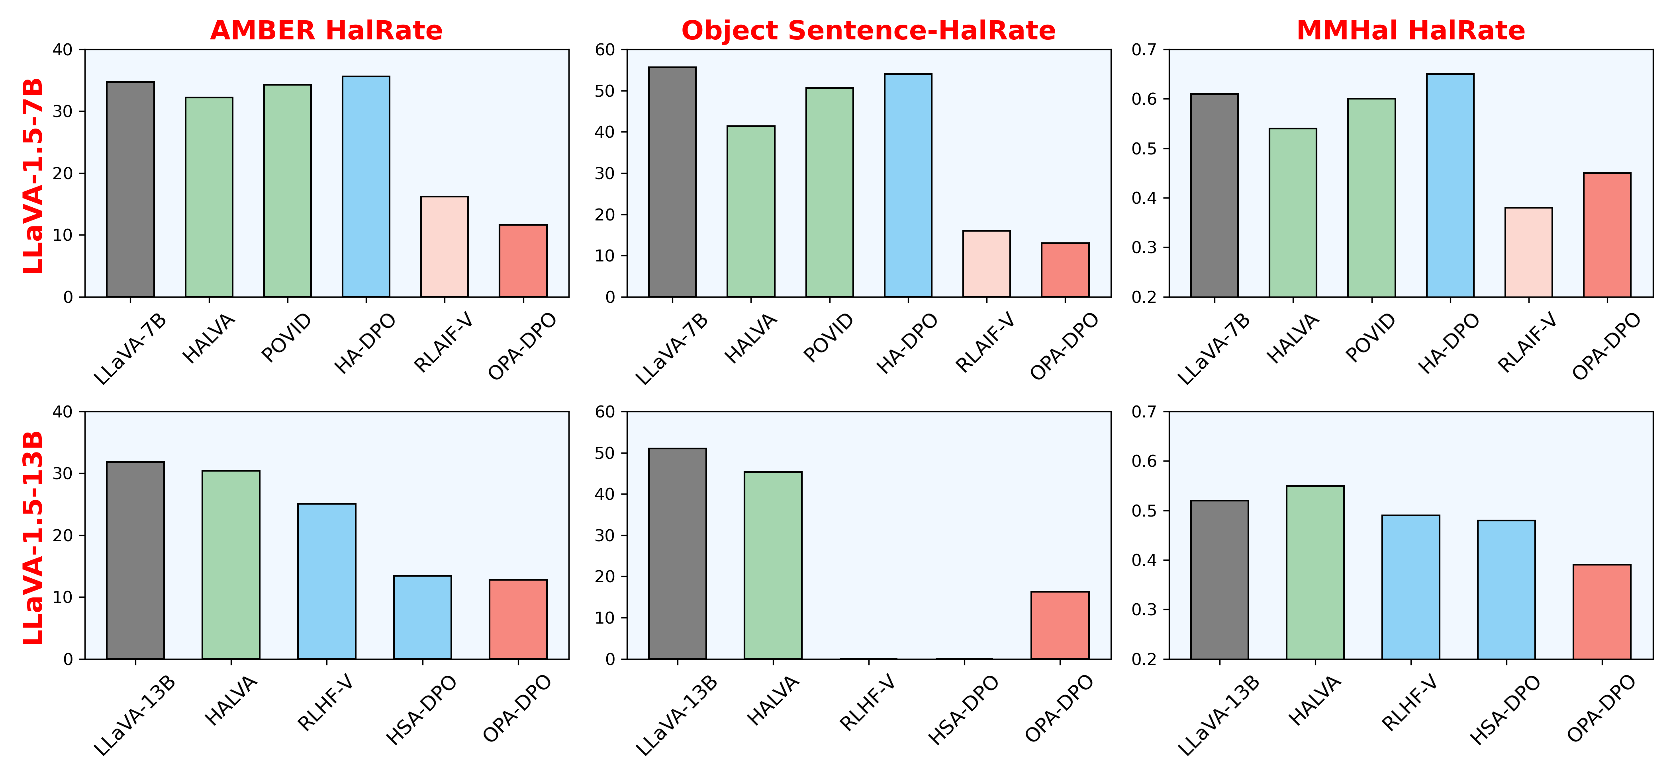
Experimental Results
Method1: Hallucination Injection
Method2: Hallucination Recognition
Method3: Self-Evolution
Lower Better
N/A
N/A
Previous SOTA (RLAIF-V)
Ours (OPA-DPO)
Data amount
16k
4.8k
Tuned Parameters
Full-tuned
LoRA
DPO Round
4
1
(Please refer to Table 1 in our paper for detailed values)
Notes:
Simplify the table (too many numbers)

Slide 16
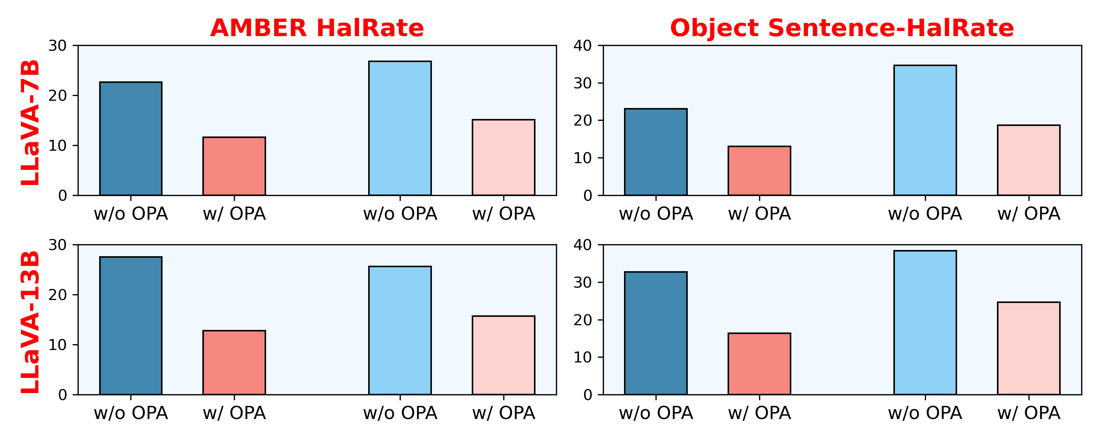
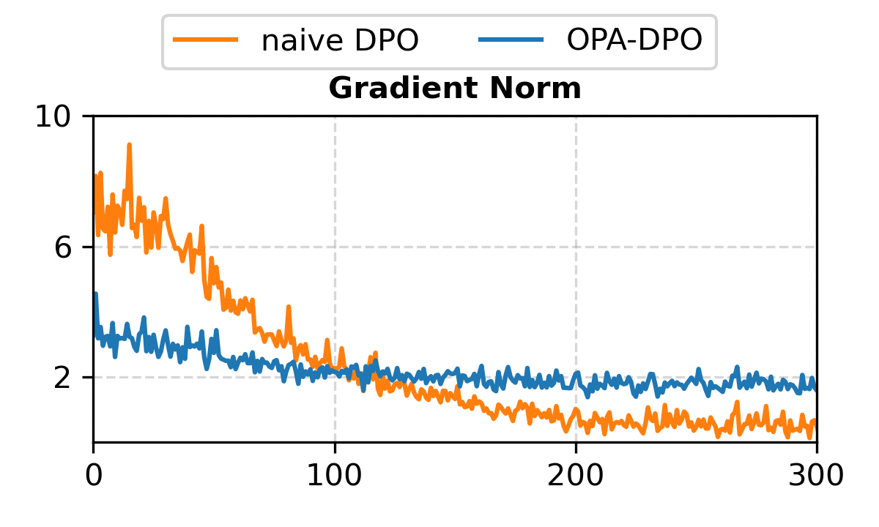
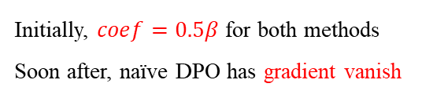
How Important the OPA operation is?
Lower Better
Data OPA
4.8k ✘
4.8k ✔
2.4k ✘
2.4k ✔
OPA results in ~ 50% $↓$ in indicators about hallucination rate!
Initially, $coef=0.5β$ for both methods
Soon after, naïve DPO has gradient vanish

Slide 17
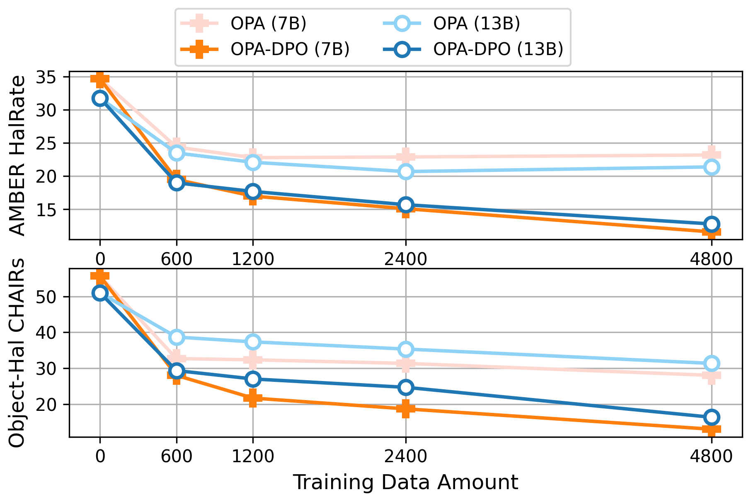
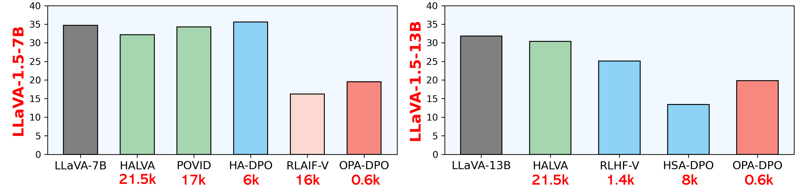
Impact of Data Scale
Lower Better
With 600 data, OPA-DPO surpasses most algorithms in hallucinations metrics.
Increasing data does NOT lead to improvements for $π_{OPA}$.
But increasing data enhance $π_{OPA}^{DPO}$ !

Slide 18
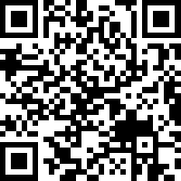
Q&A
Thanks for your listening!
More details can be found on our Project-Page
(Paper, Code, Models, Datasets)
Our Poster: ExHall D #373

